Slide 1
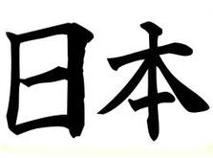
の じゅうしょ
Japanese Addresses

Slide 2
じゅうしょ (jyuusho): Addresses
Japanese jyuusho are written backwards (for Australians!)
1. Postcode
2. Prefecture (these are large areas,
the equivalent of our states,
although they are nowhere
near as big!)
3. Ku (this is like our suburb)
4. District
5. Chome (area) - Block (ban) –
Number on block
6. Building
〒100-8994
東京都
中央区
八重洲
一丁目五番三号
東京中央郵便局
〒100-8994
Tōkyō-to
Chūō-ku
Yaesu
1-Chōme 5-ban 3-gō
Tōkyō Chūō Yūbin-kyoku

Slide 3
What is the じゅうしょ ?
Using these hints, see if you can work out the divisions of the address on the business card you have.
City:都
Ku:区
Building:ビル
Floor/Level:階
What is the post code?
What is the chome-ban-go combination?
Which level is the office on?

Slide 4
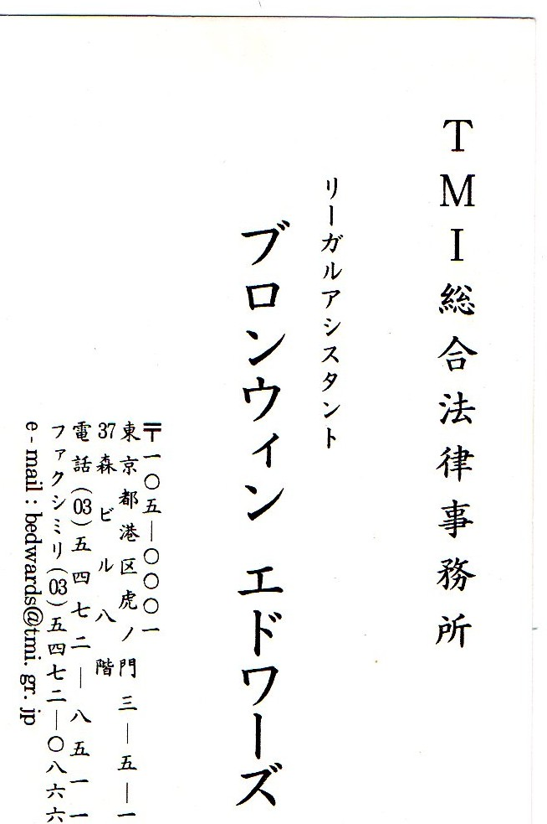

Slide 5
Write your じゅうしょ the Japanese way:
Eg. 5045
South Australia
Glenelg
Diagonal Road
Glenelg Primary School

Slide 6
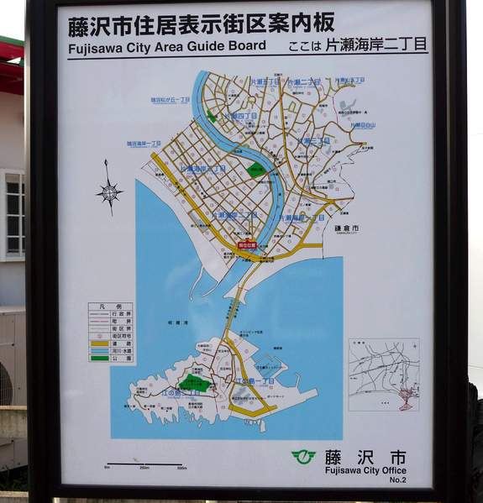
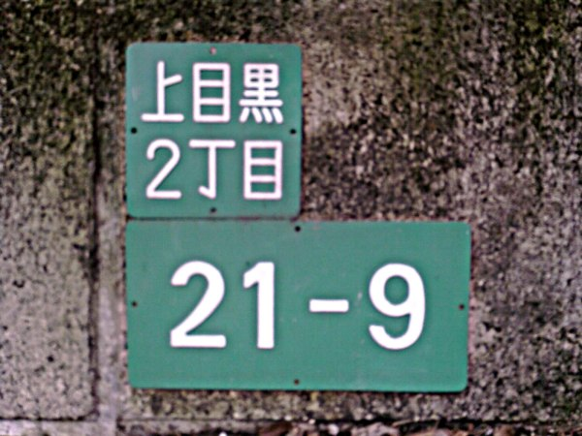
Finding your way in Japan!
Signs like these are on corners, indicating the area and block number.
There are boards like this at all the train stations and major intersections.

Slide 7
Using the address on this business card, can you find the location on your map?

Slide 8
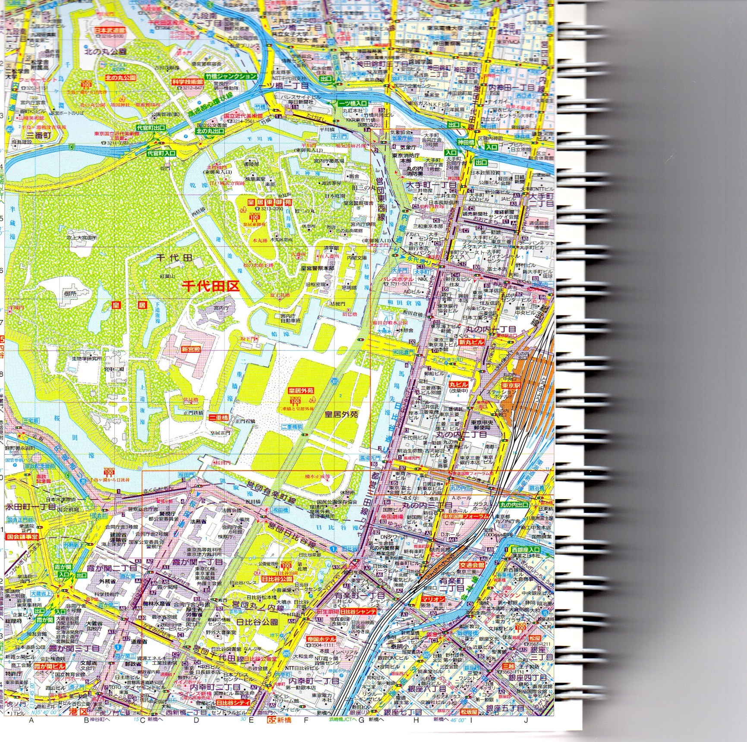

Slide 9
めいし
You must have:
Your name – written in
Your position – written in
A phone number – written in
An address – written in
An email address – written in

Slide 10
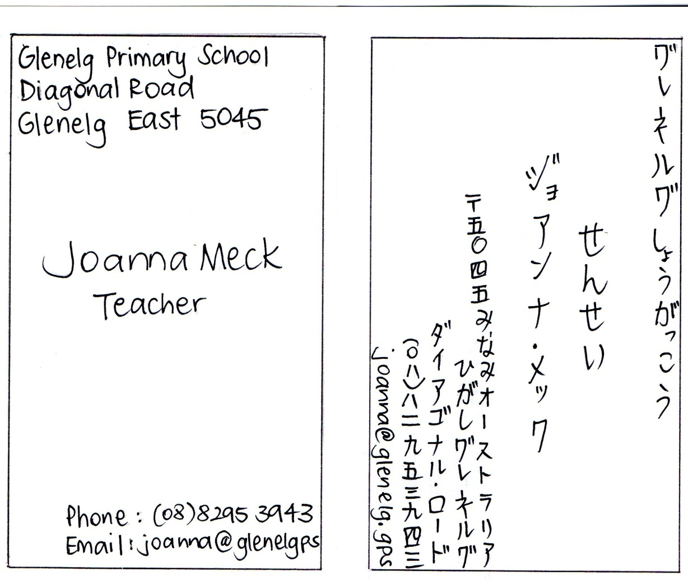
めいし
Some helpful words:
Student: せいと President/CEO:しゃちょう
Glenelg Primary
School:
グレネルグ
しょうがっこう
SA: みなみ
オーストラリア

Slide 11
Role Play!
1. When would you give/receive a めいし?
2. What are the differences between giving a Japanese めいし, and an Australian business card?
3. With a partner, create a role play to exchange your めいし. (This will all be done in Japanese!!)

Slide 12
Helpful language:

